Slide 1

Java Script ES6
Web Development
Certification Training
Copyright © 203 Xebia Group. All rights reserved. release 1.0.0

Slide 2

MODULE TOPICS
Introduction to JSON
What is JSON
JSON ARRAY FORMAT
JSON Example
Features of JSON Server
JSON Benefits
How to Set up JSON Server in an Application
JSON Server
What is React

Slide 3
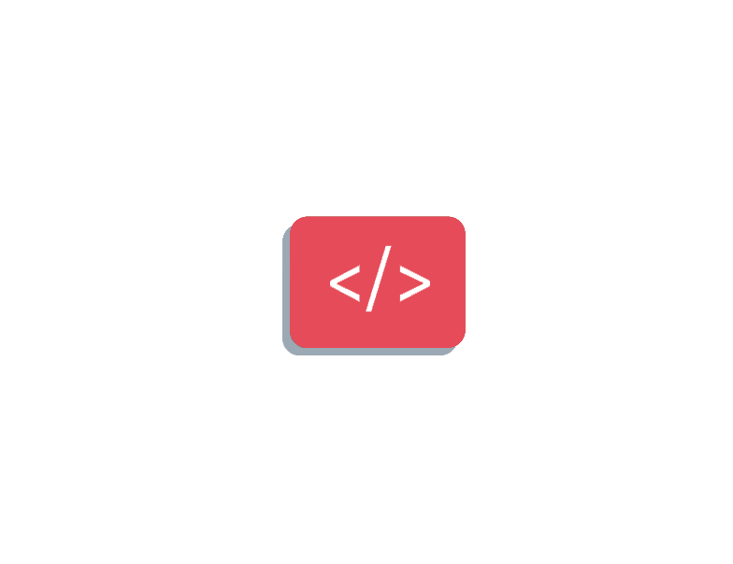

What is Json Server ?
JSON is an acronym for JavaScript Object Notation. JSON Server is a lightweight and easy-to-use Node.js tool that simulates a RESTful API using a JSON file as the data source. With JSON Server, front-end developers can create mock APIs without the need to write complex server-side code, or when a backend API isn't ready yet.

Slide 4
Array Format
[
{
"id": 1, "name": "John Doe", "age": 25
},
{ "id": 2, "name": "Jane Smith", "age": 40 }
]

Slide 5
Json Format
[
{ "id": 1, "name": "John Doe", "age": 25 },
{ "id": 2, "name": "Jane Smith", "age": 40 }
]

Slide 6
Features of JSON Server
Here are some of the features of JSON Server:
It is easy and quick to set up. It is also user-friendly for front-end developers and newbie back-end developers.
It supports common HTTP methods like the GET, POST, PUT, and DELETE methods, just like a real backend API server would.
With JSON Server, you can perform Create, Read, Update, Delete (CRUD) operations on data to build an interactive application.
JSON Server offers developers the ability to create custom routes to handle more complex scenarios.

Slide 7
Benefits of Using JSON Server
Here are some of the benefits of using JSON Server:
JSON Server grants front-end developers the ability to quickly create functional API prototypes that can be tested and modified while waiting for the backend server to be ready.
Front-end developers can use JSON Server to simulate different scenarios, and error cases during testing to enhance their application.

Slide 8
How to Set up JSON Server in an Application

Slide 9
Step #1 - Install JSON Server
To install JSON Server in your application, navigate to your project directory in your terminal or command prompt and type in this command: npm install -g json-server.
This will install the JSON server globally on your system. If you want to install it locally for just a particular project instead, use this command: npm i json-server.

Slide 10
Step #2 - Create a JSON File
Create a JSON file in your project directory that will act as the data source. This JSON file should have a .json file extension. What do I mean? Let's say you want your JSON file name to be 'db', it means you'll create a file called db.json.

Slide 11
Step #3 - Create Data
Define your data inside the JSON file. This JSON data can be an array of objects or an object with nested objects. Each object represents a data entity and should each have a unique id.

Slide 12
Step #4 - Start the Server
Start up the JSON Server by typing this command into your terminal: json-server --watch db.json. This will run on "https://localhost:3000" by default. You can change the port it's running on by specifying a different port number when starting the server using the --port flag.
For example, if you want your server to run on port 8000 instead of the default (3000), use this command while starting the server: json-server --watch db.json --port 8000. You can then view this in your browser on port 8000.

Slide 13
Creating app in React
this is basically the component that will display all user's info in a table. In your UserList.tsx file, paste these lines of code:
import React from 'react';
import { Link } from 'react-router-dom';
interface User { id: number; name: string; email: string; number: string; }
interface UserListProps { users: User[]; name: string; } const UserList: React.FC<UserListProps> = ({ users, name }) => {
return ( <> <section> <section> <h1>Users List</h1> </section> <section>
<table> <thead> <tr> <th>Name</th>
<th>Email</th>
<th>Details</th> </tr>
</thead> <tbody>
{users.map((user) => ( <tr key={user.id}> <td> <p>{user.name}</p> </td> <td> <p>{user.email}</p> </td>
<td> <Link to={`/users/${user.id}`}> <button> View full details </button> </Link> </td>
</tr> ))} </tbody>
</table> </section>
</section>
</> );
}; export default UserList;

